Slide 1
Session - 6
Reverse Engineering

Slide 2
Forward Engineering
In software development life cycle , we start from requirement phase ,analysis , design and implementation
Reverse Engineering
It is the process of creating of design document from source code and the requirements from design
These slides are designed to accompany Software Engineering: A Practitioner’s Approach, 7/e (McGraw-Hill 2009). Slides copyright 2009 by Roger Pressman.

Slide 3
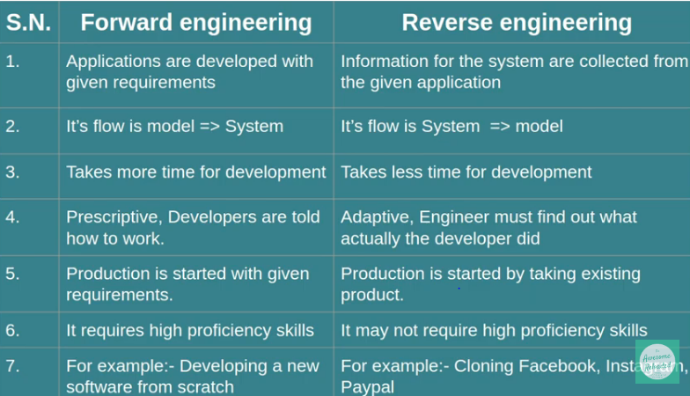
These slides are designed to accompany Software Engineering: A Practitioner’s Approach, 7/e (McGraw-Hill 2009). Slides copyright 2009 by Roger Pressman.
Notes:
Goals may be to repair/upgrde
Needed modifications might be difficult
They develop a product, but it has no document how it has not done

Slide 4
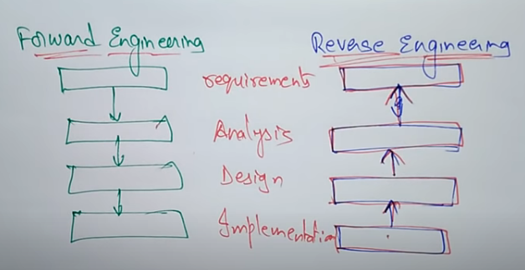
These slides are designed to accompany Software Engineering: A Practitioner’s Approach, 7/e (McGraw-Hill 2009). Slides copyright 2009 by Roger Pressman.

Slide 5
It is the process followed as to find unknown and difficult information about a software
Why it is important
It is important in case when software lacks proper documentation , and it is highly unstructured
It is degraded through maintenance works
Purpose
Recovering information from existing code and intermediate documents
Program understanding at any level it is included in RE
These slides are designed to accompany Software Engineering: A Practitioner’s Approach, 7/e (McGraw-Hill 2009). Slides copyright 2009 by Roger Pressman.

Slide 6
Reverse Engineering Goals
Recover Lost information
Cope with complexity
Detect side Effects
Synthesize higher abstraction
Facilitate reusability
These slides are designed to accompany Software Engineering: A Practitioner’s Approach, 7/e (McGraw-Hill 2009). Slides copyright 2009 by Roger Pressman.

Slide 7
Uses of reverse engineering
Program understanding
Re-documentation or document generation
Recovery of design details
Business rules implied on software
Understanding high level system description
These slides are designed to accompany Software Engineering: A Practitioner’s Approach, 7/e (McGraw-Hill 2009). Slides copyright 2009 by Roger Pressman.

Slide 8
Requirement Engineering activities
Understanding the process
Understanding the data
Understanding user interfaces
These slides are designed to accompany Software Engineering: A Practitioner’s Approach, 7/e (McGraw-Hill 2009). Slides copyright 2009 by Roger Pressman.

Slide 9
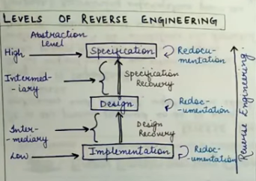
These slides are designed to accompany Software Engineering: A Practitioner’s Approach, 7/e (McGraw-Hill 2009). Slides copyright 2009 by Roger Pressman.

Slide 10
Questions:
Need of Reverse engineering.
How Forward Engineering work.
Different levels of reverse engineering

